Slide 1
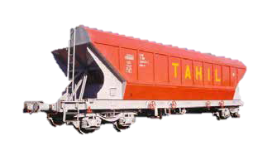
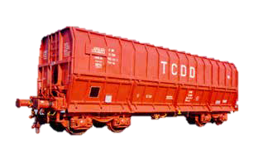
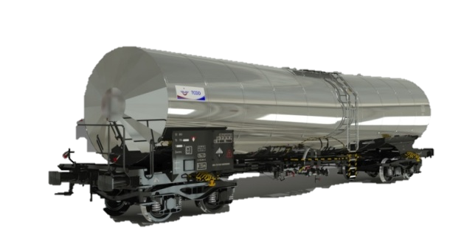
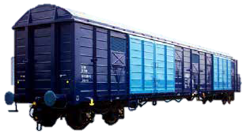
Heart of Freight Wagon Production in Turkey
TÜRKİYE DEMİRYOLU MAKİNALARI SANAYİİ A.Ş.
TURKISH RAILWAY MACHINES INDUSTRY INC.

Slide 2
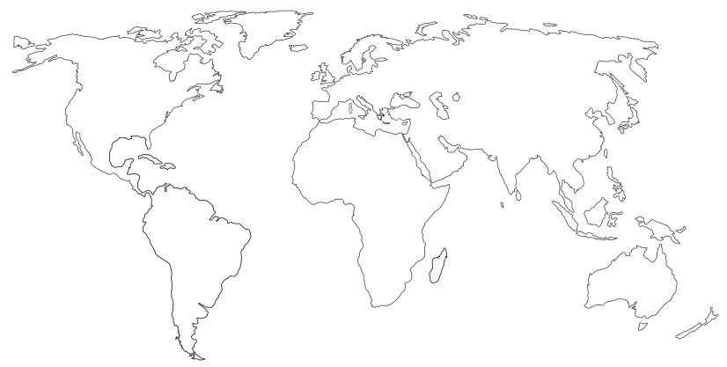
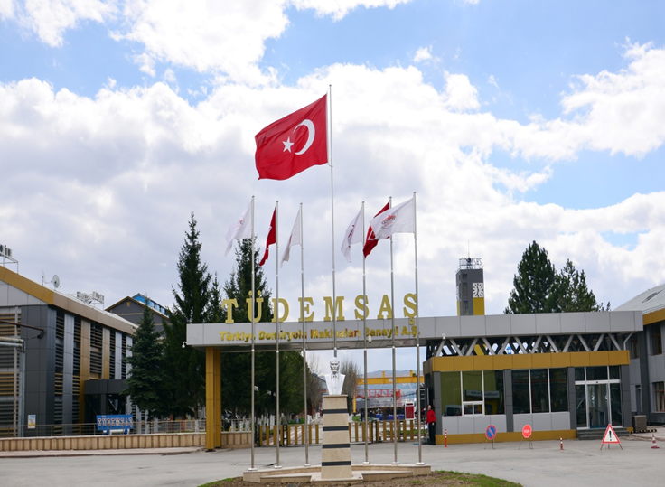
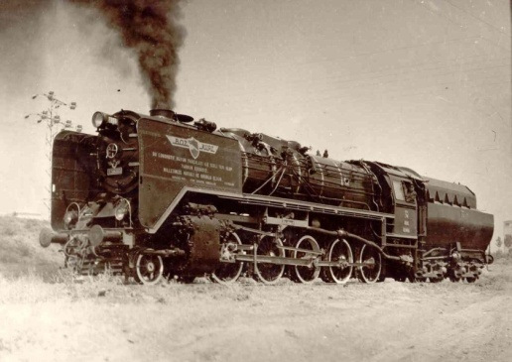
WHERE ARE WE?
İstanbul
Ankara
Sivas

Slide 3
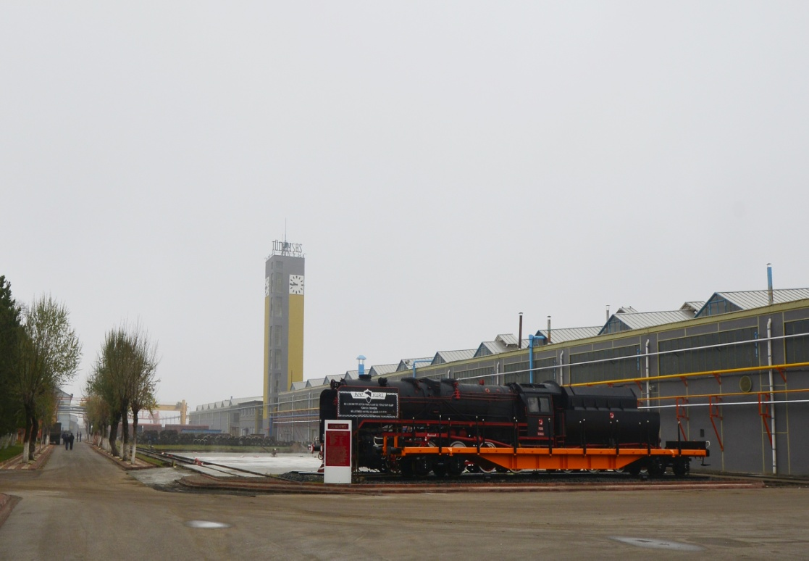
Main Business : FREIGHT WAGON
TOTAL AREA : 418.000 m²
INDOOR AREA : 110.000 m²
PERSONNEL : 1098 workers
(787 blue collar+ 311 white collar)
An affiliated company owned by TCDD
Freight wagons
Production
Maintenance & Repair / Revision
Refurbishment
Notes:
End of May 2018 : 870 blue collar, 330 white collar workers, to round up or down
TCDD has 4 Affiliated Companies; TÜLOMSAŞ, TÜDEMSAŞ, TÜVASAŞ and recently established TCDD Taşımacılık A.Ş.

Slide 4
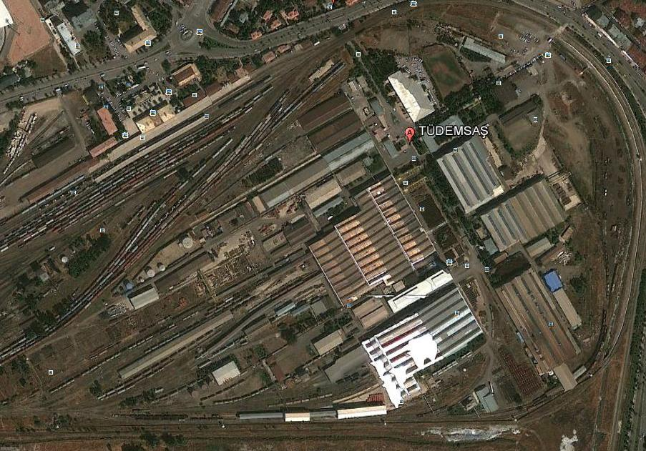
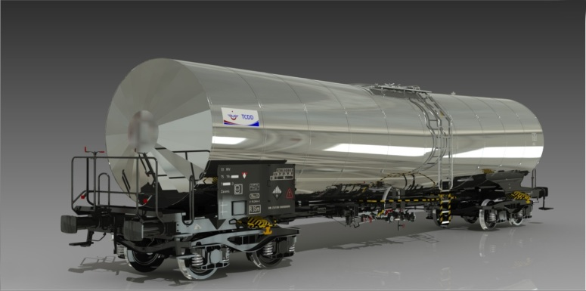
HISTORY
1939 – Inaugurated
by the name of «SİVAS CER ATELYESİ».
(Sivas Traction Workshop)
1961 –First steam engine locomotive
BOZKURT (Gray Wolf) was locally
produced .
1975–Name changed as SİDEMAS
(Sivas Railway Machines Industry.
1986–Name and status changed as
TÜDEMSAŞ
(Turkish Railway Machines Industry
Incorporated).
Notes:
History with milestones
1934-Foundation work started.
1953-First party of freight wagons were produced and put into service.
1958-Name was changed as «Sivas Railway Factories»
2002-2003- 240 pcs of Petroleum Products Carrying Wagons were exported to Iraq.

Slide 5
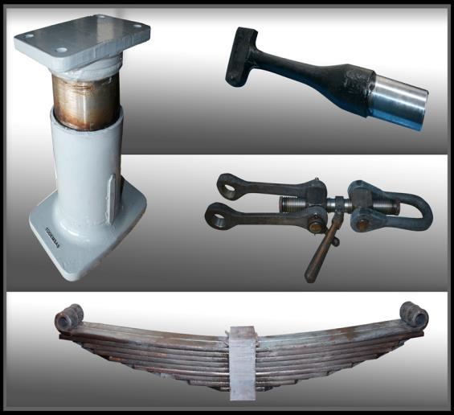
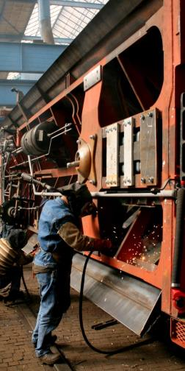
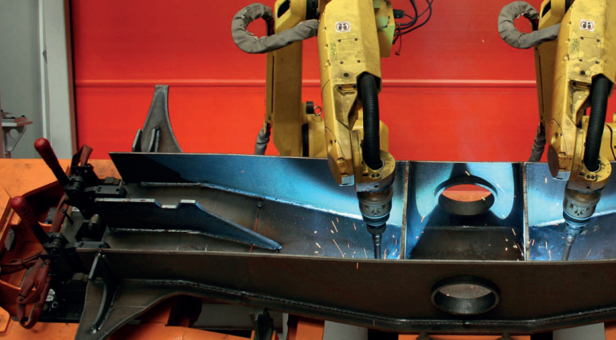
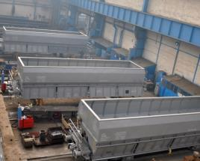
PRODUCTION
Conforming to International Standards;
BOGIE PRODUCTION
WAGON ASSEMBLY
SHOT BLASTING and PAINTING
SPARE PARTS (BUFFERS, BRAKE AIR HOSES, LEAF SPRINGS etc.)
Notes:
Bogie production by semi automatic robot welding.

Slide 6
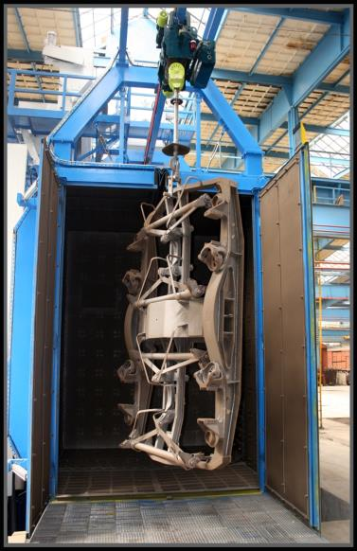
MAINTENANCE & REPAIR and REVISION
REPAIRWORK
PERIODICAL MAINTENANCE
REFURBISHMENT / MODIFICATION
(Altering the type of wagons)
ROBOTIC SHOT BLASTING of WAGONS
ULTRASONIC INSPECTION of WAGON AXLES
REPROFILING of WHEELS
Bogie shot blasting cabin
Notes:
Periodical maintenance each 5-6 years
New investments for ECM

Slide 7
UP TILL NOW
Over 22 000 freight wagons of 31 types
have been produced since 1953.
Maintenance-repair and revision of around 350 000
wagons of various types
have been realized since 1939.
Notes:
So far, until now,
22483 pcs ; 2019-1953=66---------22000/66=333
349 890 pcs; 2019-1939=80---------350000/80=4375

Slide 8
PRODUCTION CAPACITY
750 WAGONS PER YEAR
MAINTENANCE AND REPAIR CAPACITY
2500 WAGONS PER YEAR
Notes:
Approximately 750 wagons.

Slide 9
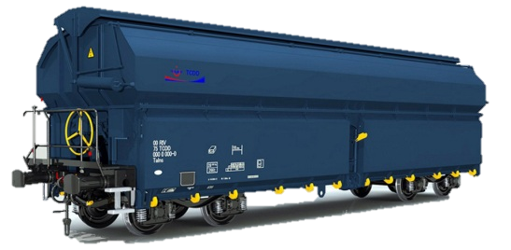
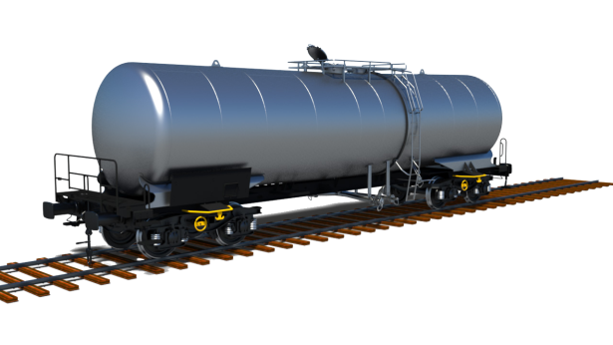
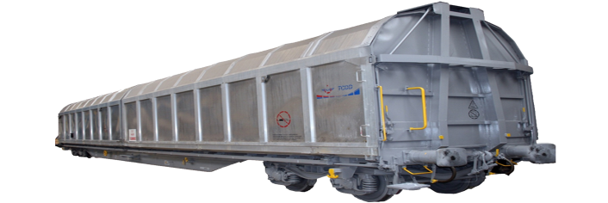
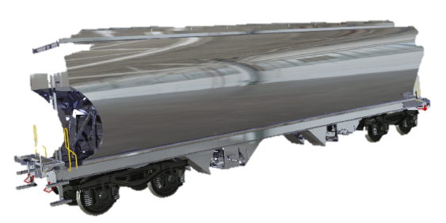
Ore Transport Wagon
Tank Wagon
Container Wagon
WAGON TYPES
Covered Wagon with Aluminum Sliding Walls
Cereals Wagon
Notes:
Depending on the type of product to transport
iron ore, minerals, flat wagon,containers,cereals, granular, grains, wheat, household goods, refrigerators, washing machines, light/heavy petroleum products

Slide 10
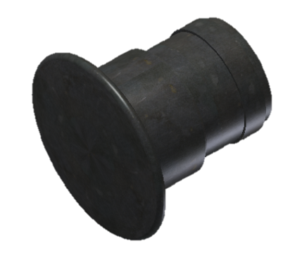
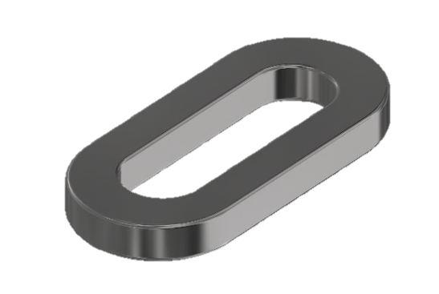
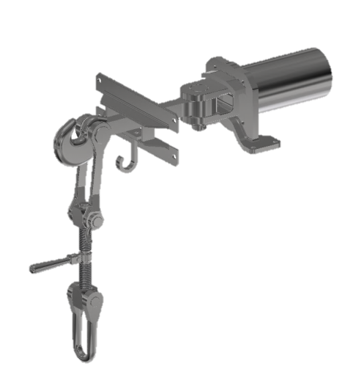
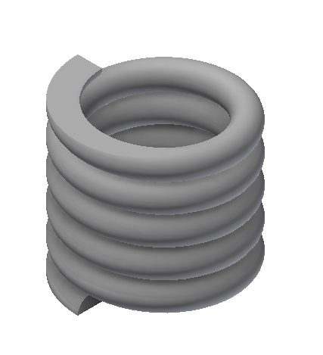
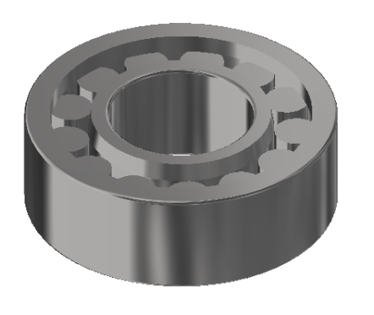
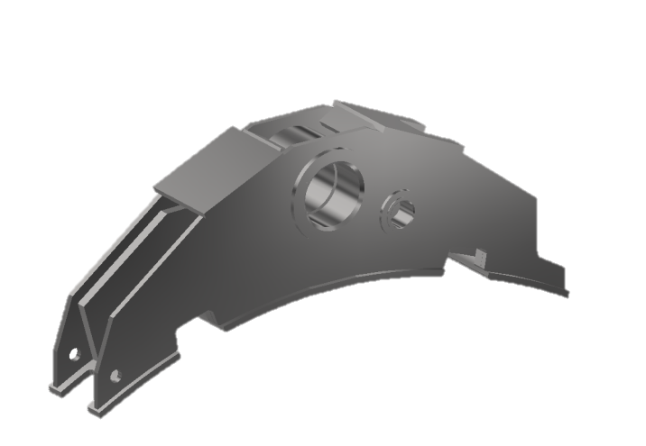
Buffer
Screw Coupling System
Lenoir Link
OUTSOURCED WAGON PARTS
Helical Spring
Roller Bearing
Brake Shoe Holder
Notes:
Draft Gear/Draw Gear + Draw Hook + Screw Coupling= Screw Coupling System
Yan yastık alt ve üst oturma parçaları

Slide 11
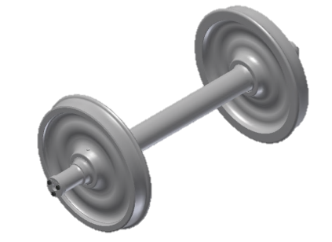
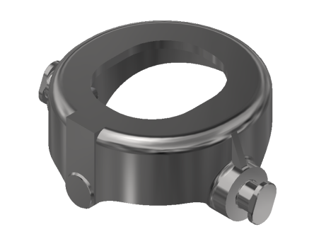
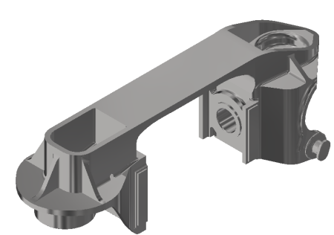
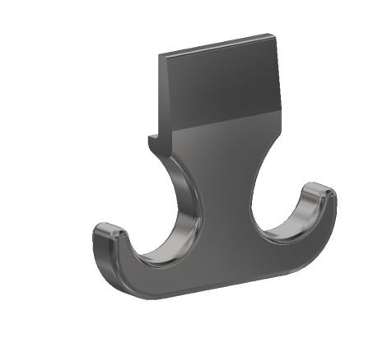
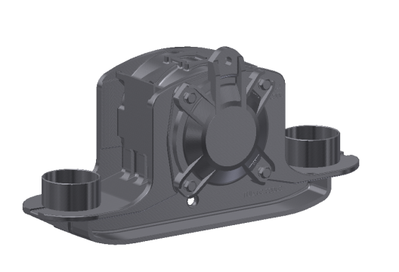
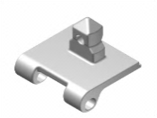
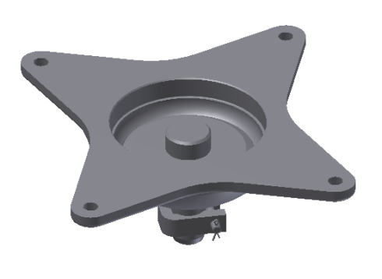
Wheelset
Helical Spring Support
Wheelset Guiding System
OUTSOURCED WAGON PARTS
Tow Hook
Axle Box
Container Spigot
Bogie Pivot Center

Slide 12
WAGONS ALREADY PRODUCED (TSI)
Rgns 60’ PLATFORM WAGON
Sgns 60’ CONTAINER WAGON
Talns 80 m3 ORE TRANSPORT WAGON
Zacens 78 m3 TANK WAGON(INTERNALLY HEATED)
Sggmrs 90’ ARTICULATED CONTAINER WAGON
BOGIES ALREADY PRODUCED (TSI)
Y25Lsd(f)-KC1
KNORR CFCB
WABTEC IBB10
Y25Ls(s)d1 with front and rear beams
Y25 Lsdi(f)-KC1 (H-Type)

Slide 13
ONGOING WAGON PROJECTS and PRODUCTION
Sgmmns(s)-45’ CONTAINER WAGON
Sdgmns - MILITARY TANK TRANSPORT WAGON
Zans 87 m³ TANK WAGON FOR LIGHT OIL PRODUCTS
Sggrs 80’ ARTICULATED CONTAINER WAGON
TARGET WAGON PROJECTS
Sdggmrs POCKET WAGON (For SEMITRAILERS)
Uagnpps CEREALS WAGON
Sggns 80’ CONTAINER WAGON (SINGLE UNIT)

Slide 14
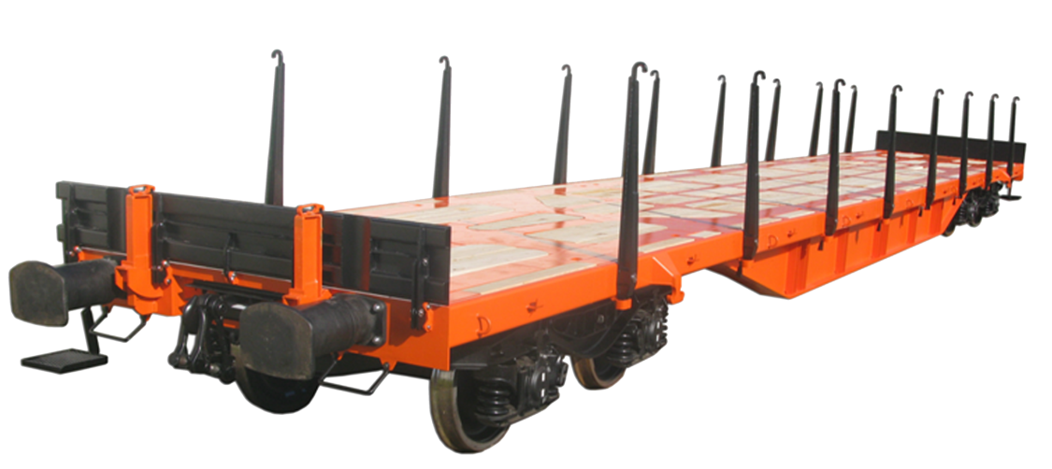
WAGONS ALREADY PRODUCED (TSI)
Rgns 60’ PLATFORM WAGON
Technical Characteristics :
Tare : ~21 t
Payload : ~ 69 t
Axle Load : 22,5 t
Max. Speed : 120 km/h (empty)
Freight : 20, 30, 40’ containers ,
long / flat goods and block loads
Platform Height : 1150 mm
(from rail surface)
Notes:
2016 yılında 500 adet üretimi yapıldı.
BOJİ TİPİ: Y25Lsd(f)-KC1
CFCB Kompakt Fren Sistemi
Vagon boyu düzeltilecek.

Slide 15
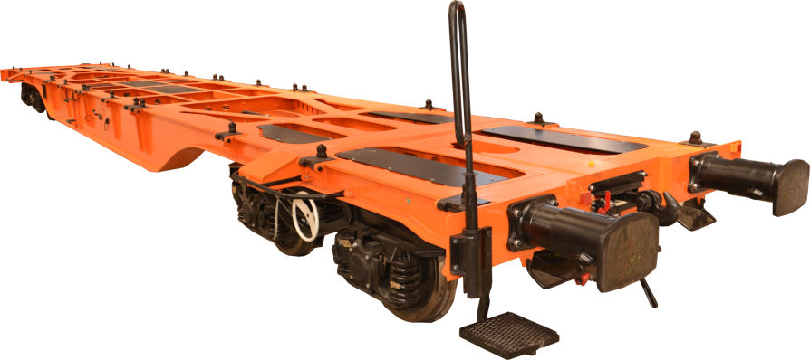
WAGONS ALREADY PRODUCED (TSI)
Sgns 60’ CONTAINER WAGON
Technical Characteristics :
Tare : ~17 t
Payload : ~ 73 t
Axleload : 22,5 t
Max.Speed : 120 km/h (empty)
Hamule : 10’, 20’, 30’, 40’ containers and
their combinations
Notes:
2016 yılında 200 adet üretimi tamamlanmış ve teslim edilmiştir.
BOJİ TİPİ: Y25Lsd(f)-KC1
IBB10 Kompakt Fren Sistemi

Slide 16
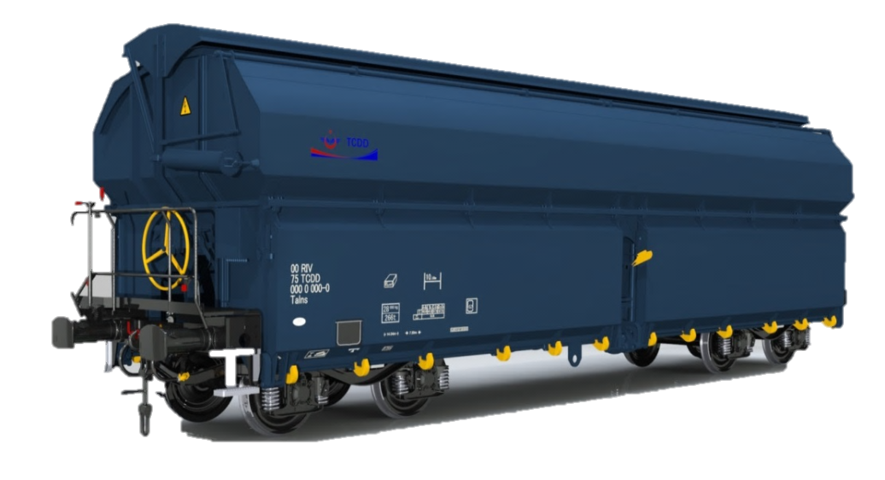
WAGONS ALREADY PRODUCED (TSI)
Talns 80 m³ ORE TRANSPORT WAGON
Technical Characteristics:
Tare : ~24 t
Payload : ~66 t
Axle Load : 22,5 t
Max. Speed : 120 km/h (empty)
Freight : bulk cargo
Pneumatically operated top cover and side walls
Notes:
BOJİ TİPİ: Y25Lsd(f)-KC1
Frenleme Rejimi:’S’

Slide 17
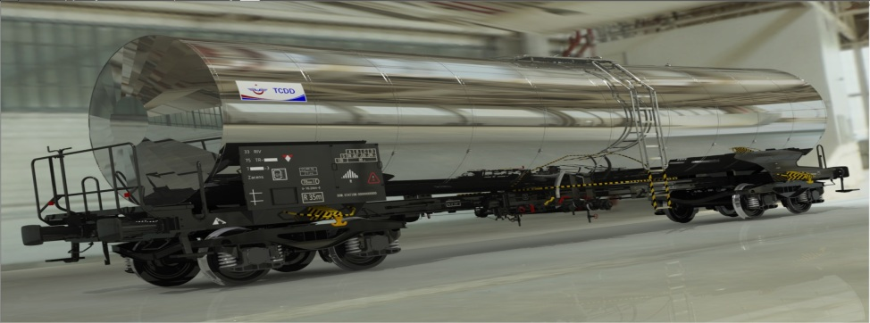
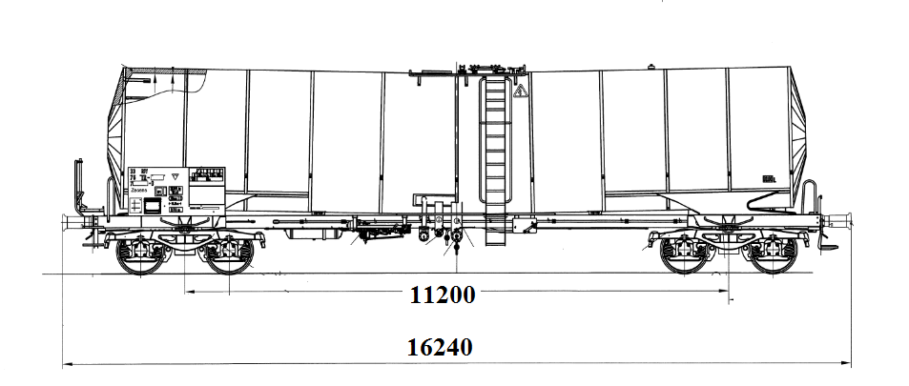
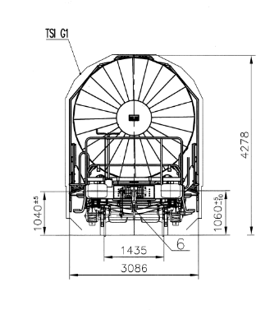
WAGONS ALREADY PRODUCED (TSI)
Zacens TANK WAGON (Internally Heated)
Technical Characteristics :
Tare : ~25 t
Payload : ~65 t
Volume : 78 m³
Axle Load : 22,5 t
Max. Speed : 120 km/h (empty)
Freight : heavy oil products, tars
(incl.coal tar), asphalt, bitumen
Notes:
BOJİ TİPİ: Y25Ls1-K
TANK TİPİ: L4BH
FRENLEME REJİMİ: ‘s’
Zacens VAGONU PROJE DURUMU
Proje tamamlandı,
Internally heated from the bottom.
Insulated.

Slide 18
WAGONS ALREADY PRODUCED (TSI)
Sggmrs 90’ CONTAINER WAGON
Technical Characteristics :
Tare : 26 t
Payload : 109 t
Axle Load : 22,5 t
Max. Speed : 120 km/h (empty)
Freight : 20’, 30’, 40’, 45’ containers
and various combinations of
20’, 30’ containers
Notes:
BOJİ TİPİ: Y25Lsdi(f)-KC1 (H tipi)

Slide 19
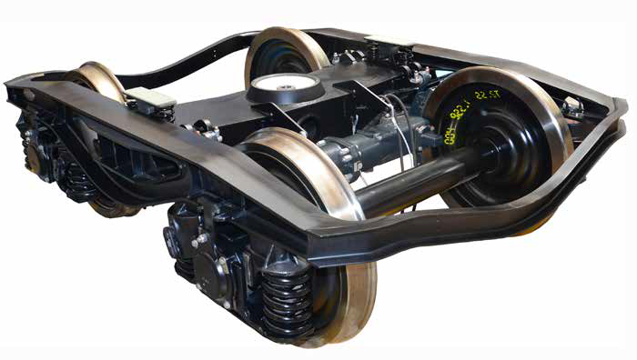
BOGIES ALREADY PRODUCED (TSI)
BOGIE-Y25Lsd(f)-KC1
Technical Characteristics :
Axle Load : 22,5 t
Max. Speed : 120 km/h
Wheel Diameter : 920 mm
Tare : ~4,2 t
Brake System : CFCB (Knorr-Bremse)
or IBB10 (Wabtec)

Slide 20
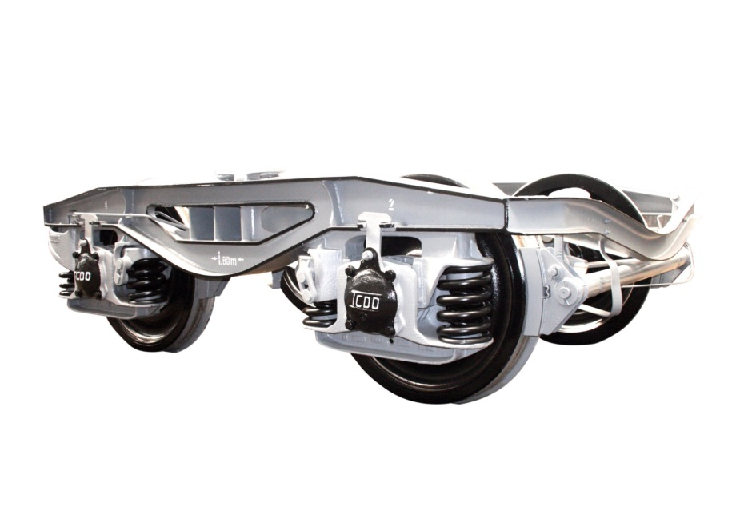
BOGIES ALREADY PRODUCED (TSI)
BOGIE-Y25Ls(s)d1
Technical Characteristics :
Axle Load : 22,5 t
Max. Speed : 120 km/h
Wheel Diameter : 920 mm
Tare : ~4,6 t
Brake System : Conventional

Slide 21
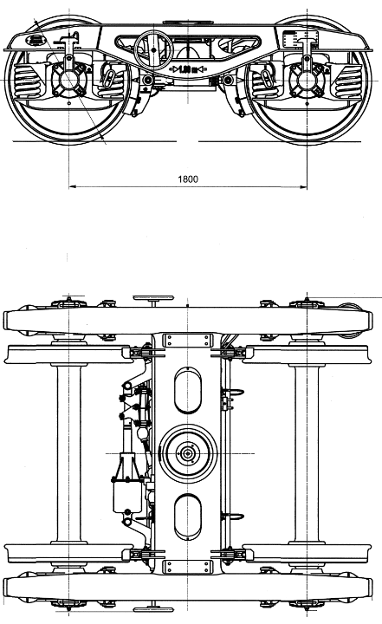
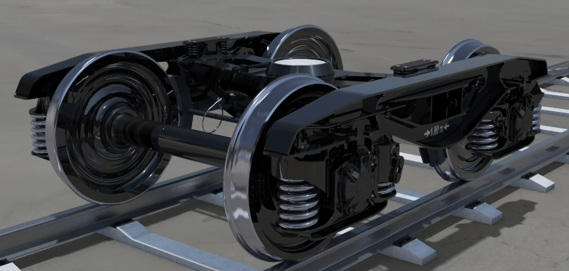
BOGIES ALREADY PRODUCED (TSI)
BOJİ-Y25Lsdi-KC1(H Tipi)
Technical Characteristics :
Axle Load : 22,5 t
Max. Speed : 120 km/h
Wheel Diameter : 920 mm
Tare : ~4 t
Brake System : IBB10 (Wabtec)

Slide 22
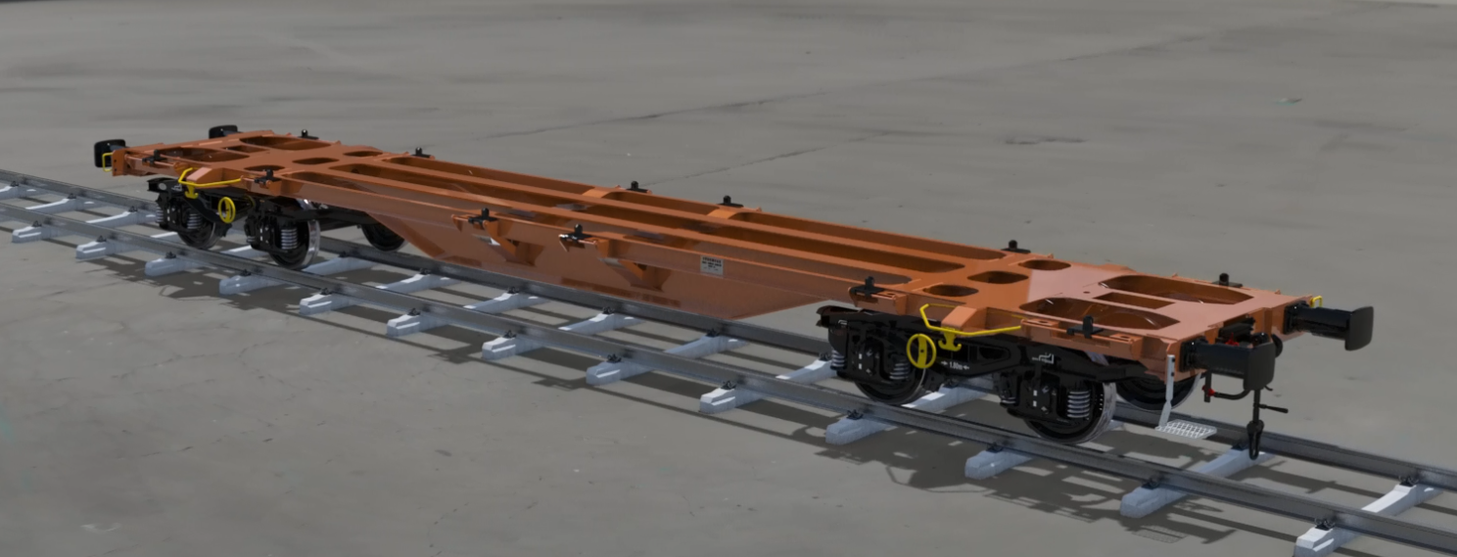
ONGOING WAGON PROJECTS and PRODUCTION
Sgmmns(s) 45’ CONTAINER WAGON
Technical Characteristics :
Tare : ~17 t
Payload : ~73 t
Axle Load : 22,5 t
Max. Speed : 120 km/sa Freight : 20’ ,30’,40’,45’
containers and
swap bodies
Brake System : Conventional

Slide 23
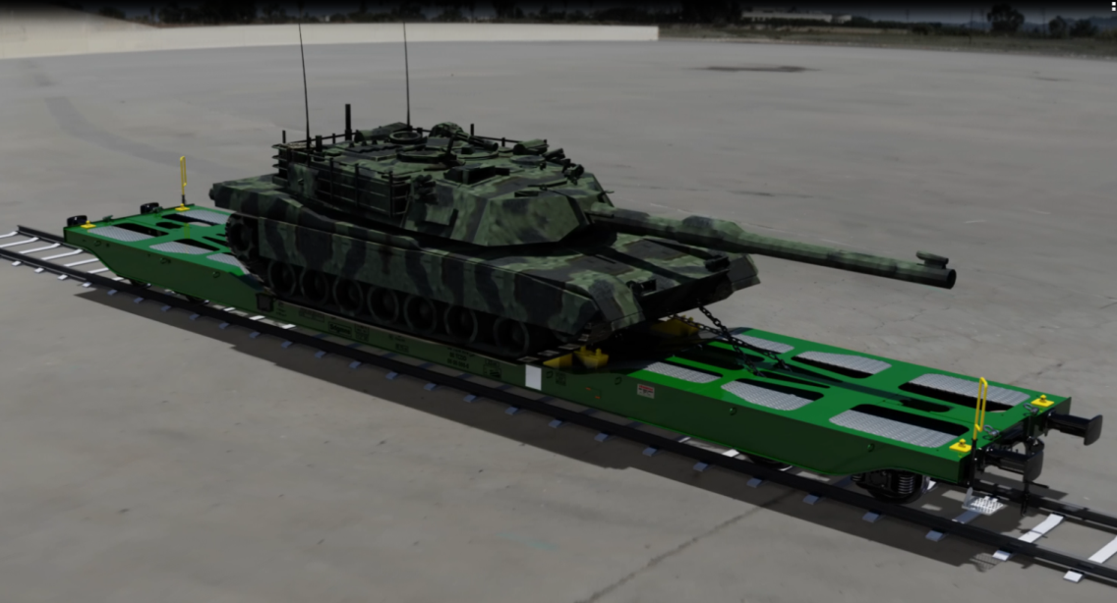
ONGOING WAGON PROJECTS and PRODUCTION
Sdgmns MILITARY TANK TRANSPORT WAGON
Technical Characteristics :
Tare : 23,5 t
Payload : 66,5 t
Axle Load : 22,5 t
Max. Speed : 120 km/h (unladen)
Freight : 20’, 40’ containers,
heavy construction equipment,
military vehicles
and marble blocks
.

Slide 24
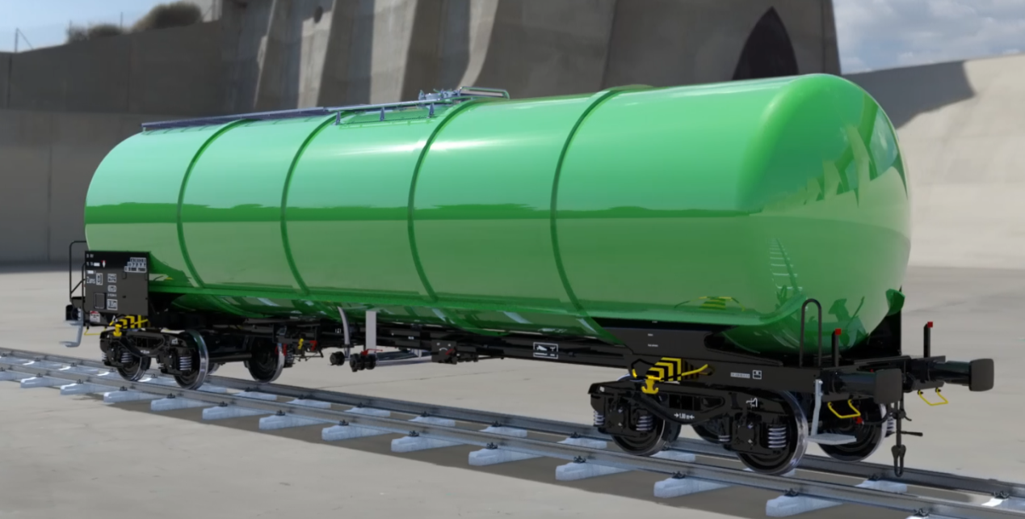
ONGOING WAGON PROJECTS and PRODUCTION
Zans 87 m³ TANK WAGON FOR LIGHT OIL PRODUCTS
Technical Characteristics:
Tare : ~21 t
Volume : 87 m³
Axle Load : 22,5 t
Max. Speed : 120 km/h (empty)
Freight : light oil products

Slide 25
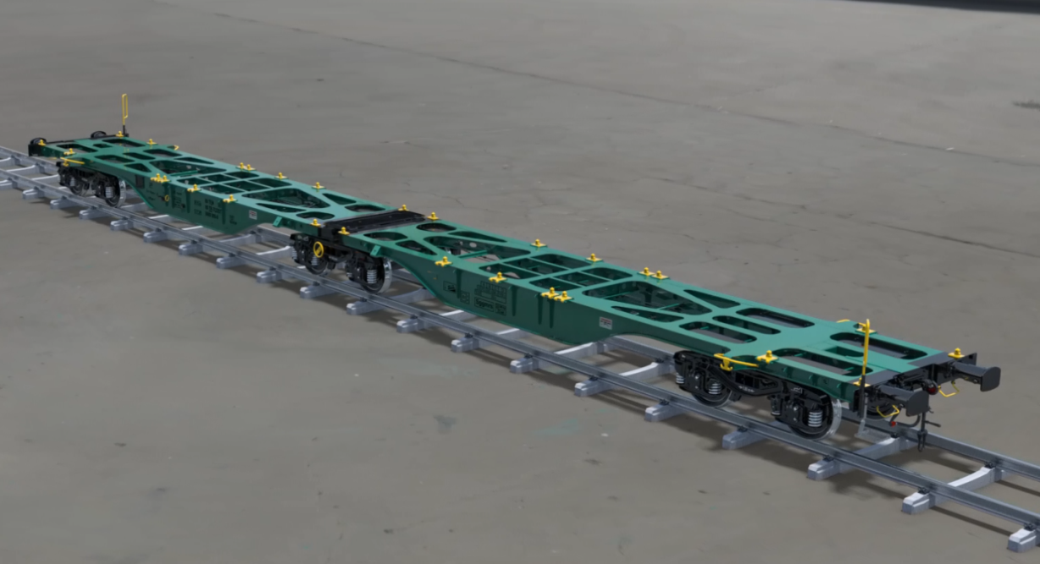
ONGOING WAGON PROJECTS and PRODUCTION
Sggrs 80’ ARTICULATED CONTAINER WAGON
Technical Characteristics :
Tare : ~25 t
Payload : ~110 t
Axle Load : 22,5 t
Max. Speed : 120 km/h (unladen)
Freight : 20’ ,30’,40’ containers

Slide 26
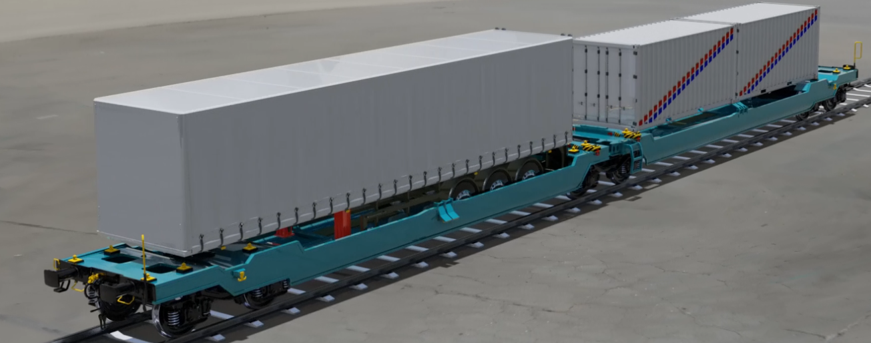
TARGET WAGON PROJECTS
Sdggmrs POCKET WAGON (For SEMITRAILERS)
Technical Characteristics :
Tare : ~33 t
Payload : ~102 t
Axle Load : 22,5 t
Max. Speed : 120 km/h (unladen)
Freight : 20’, 24’, 26’, 30’, 40’, 45’
containers, semitrailers
7.82 m ,13,6 m,13,72 m
swap bodies

Slide 27
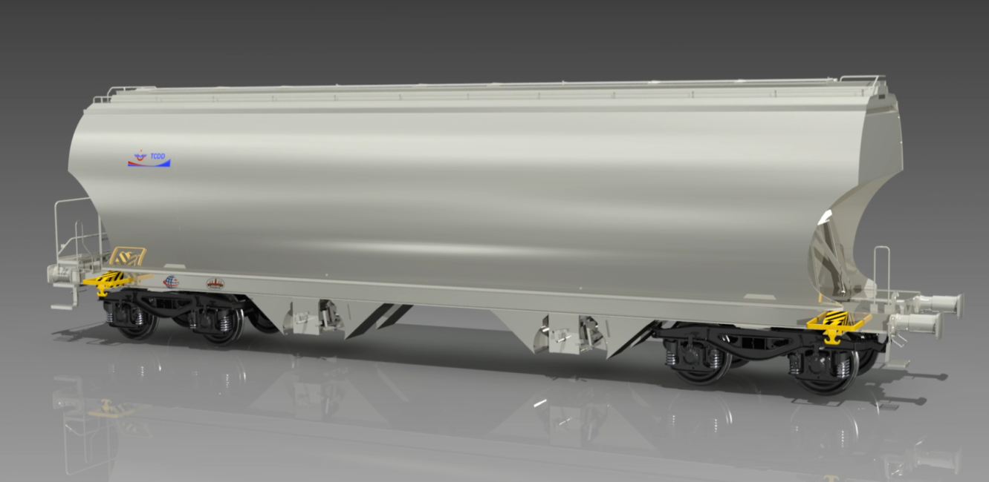
TARGET WAGON PROJECTS
Uagnpps CERERALS WAGON
Technical Characteristics :
Tare : ~33 t
Payload : ~102 t
Axle Load : 22,5 t
Max. Speed :120 km/h (empty)
Freight : Products like soya
bean, corn, wheat
needed to protect
against adverse
wheather conditions

Slide 28
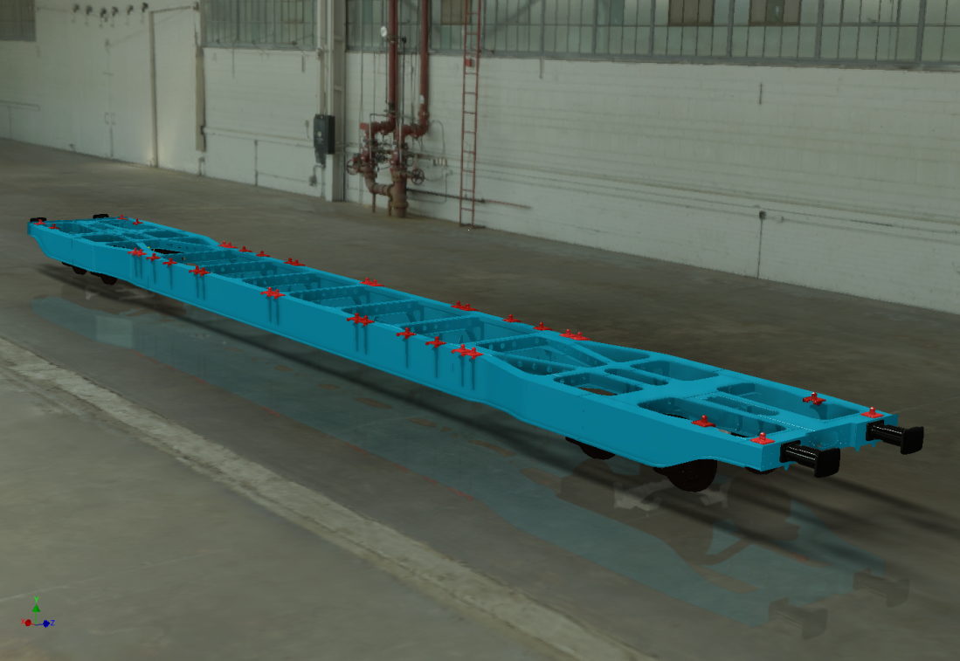
TARGET WAGON PROJECTS
Sggns 80’ CONTAINER WAGON (SINGLE UNIT)
Technical Characteristics :
Tare : ~22 t
Payload : ~68 t
Axle Load : 22,5 t
Max. Speed : 120 km/h (unladen)
Hamule : 20’, 26’, 30’, 40’, 45’
containers

Slide 29
OUR CERTIFICATES
TS EN ISO 9001:2015
QUALITY MANAGEMENT SYSTEM
TS 18001:2008 OHSAS
OCCUPATIONAL HEALTH AND SAFETY
MANAGEMENT SYSTEM
TS EN ISO 14001:2004
ENVIRONMENTAL MANAGEMENT SYSTEM
TS EN 16001
ENERGY MANAGEMENT SYSTEM
TS EN 15085-2
WELDING OF RAILWAY VEHICLES AND COMPONENTS

Slide 30
Supporting Rail Industry in Sivas
High quality
at low cost
thanks to regional clustering
Direct employment of 600 persons
Export opportunities with high quality products at low cost thanks to the emerging public private partnerships with subsidiary industry around Sivas.

Slide 31
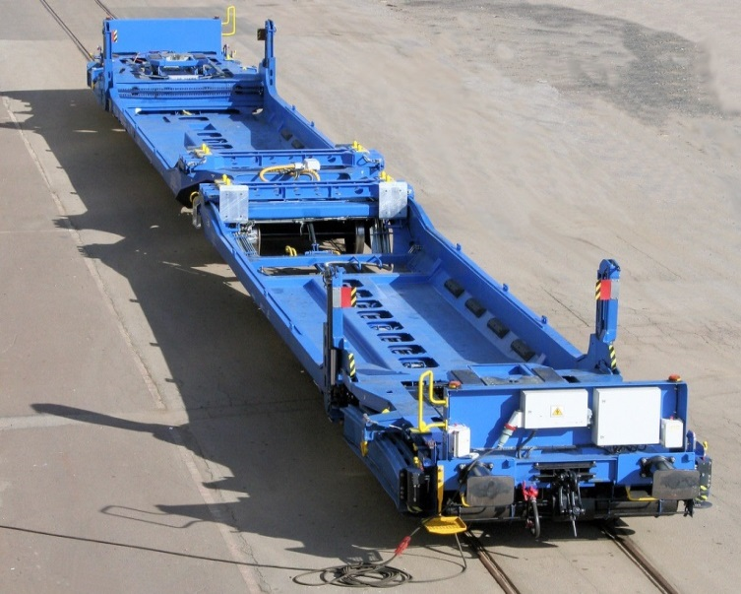
Supporting Rail Industry in Sivas
PROJECTS for EUROPE
POLAND : 2 pcs of Sgns type freight wagon (delivered)
GERMANY : 18 pcs of Megaswing Pocket Wagon (In progress for serial production)
AUSTRIA: 150 pcs of 80 feet Container Wagon (Preperation for serial production is underway)

Slide 32
Supporting Rail Industry in Sivas
PROJECTS for EUROPE
AUSTRIA: 120 pcs of bogies (delivered)
SWITZERLAND : 50 pcs of bogies (delivered)
(for 25 pcs of 80 feet Container Wagons)
CROTIA : 340 pcs of bogies (Contract signed)

Slide 33
TRAINING CENTER for WELDING TECHNIQUES
OPENING : June 2013
Welders of TÜDEMSAŞ,
Welders in TCDD,
Welders in private companies
Training Center for Welding Techniques
Total Number of Trainees | 2308
Total Number of Certified Trainees | 1851
Certificates Given
TÜDEMSAŞ | 1173
TCDD | 347
Private Enterprises | 304
Individuals | 258
Mayıs 2019

Slide 34
TÜDEMSAŞ
Türkiye Demiryolu Makinaları Sanayi AŞ

Slide 35
Thank you for your attention.
Zühtü ÇOPUR
Mechanical Engineer
Head of Quality Control Department
Email : zuhtucopur@tudemsas.gov.tr
zuhtucopur@yahoo.com

